Slide 1
Shakyamuni, the Buddha
The Life in Buddhist Texts and Legends

Slide 2
Buddhists define themselves:
Three- Jewels/Refuges=
TRI- RATNA/ TRI-SARANA
Buddha
THE SAGE
Dharma
HIS TEACHINGS
Sangha
HIS COMMUNITY

Slide 3
Buddha
बुदध
“ONE WHO HAS AWAKENED”

Slide 5
Buddha “one who has awakened”
His life’s narrative is a model for Buddhists and a subject of primary interest and reference

Slide 6
Queen Maya’s Dream/ Birth

Slide 7
Birth from his mother’s right side, while grasping a tree

Slide 8
Gods bathe infant Siddhārtha

Slide 9
Seven Steps…

Slide 10
Vows and Proclamations

Slide 11
Siddhartha nursed by Gotami, his stepmother

Slide 12
Aryan Society in 6th century India: Caste and Religion of Sacrificial Rituals performed by Brahmins
“twice-born” groups

Slide 13
Context: Vedic Hinduism centered on fire cult, priesthood

Slide 14
Asita’s Tears and Prediction TWO ALTERNATIVES

Slide 16
Named: “Siddhartha”
“One will accomplish his goal”
(Gautama is his clan name)

Slide 17
Meditation at Plowing ceremony
Excelling his teachers

Slide 18
Leaving home to study with a guru

Slide 19
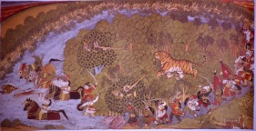
Training as Kshatriya, Warrior Caste

Slide 20
Competition for Yashodhara

Slide 21
Marriage

Slide 24
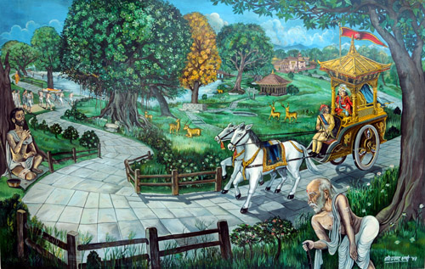
Four Passing Sights: Old, Sick, Dead, Shramana

Slide 25
“Great Departure”

Slide 27
Studying with Shramana Teachers Wanderers Dwelling in Forests Yoga and Trance Meditation

Slide 29
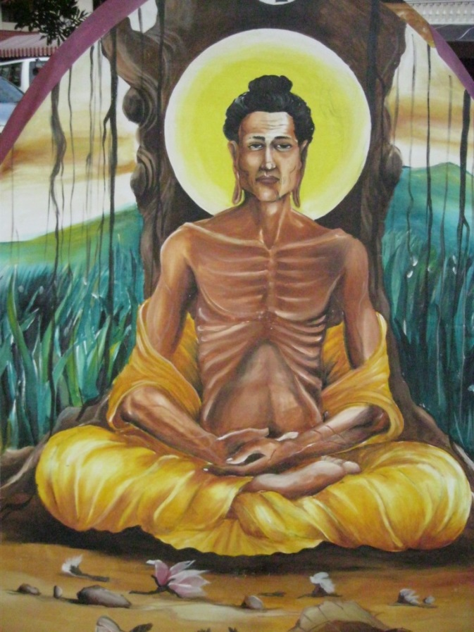
Seeking the truth from Extreme Asceticism esp. fasting

Slide 30
Mother’s Dream
and the
Gift of Sujata

Slide 31
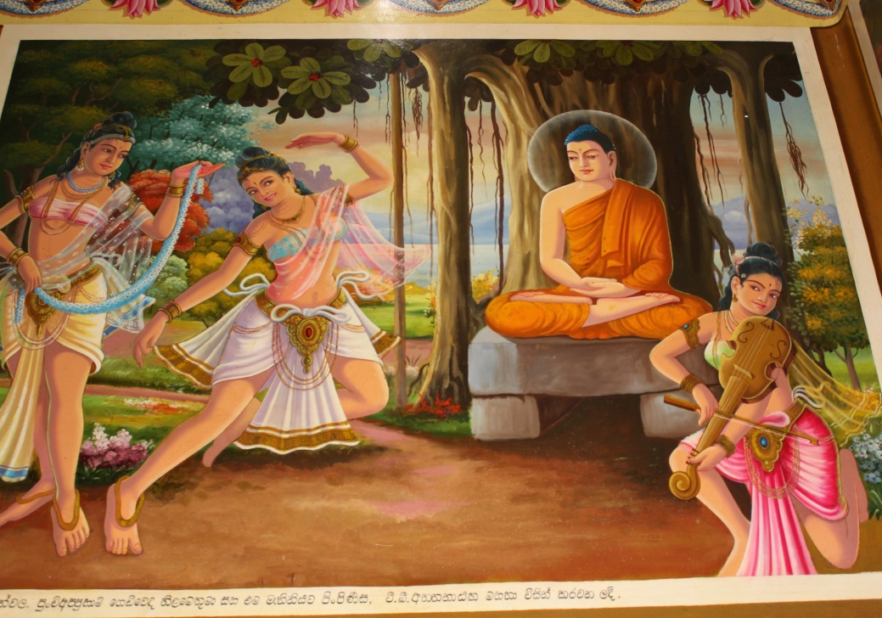
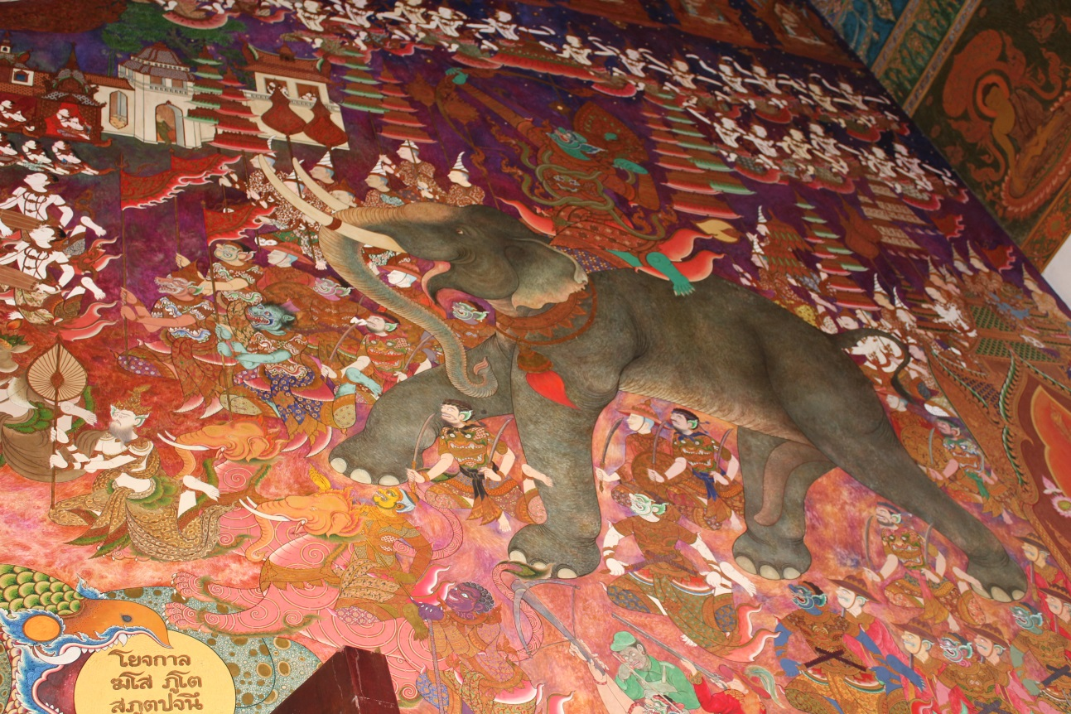
Temptations of Mara
Overcoming lust/desire
Overcoming fear

Slide 32
Earth Touching Gesture BHUMI-SPARSA MUDRA
Earth bears witness to his virtue and washes away Mara’s hordes

Slide 33
Finds tree, vows to achieve breakthrough… or die

Slide 34
Recollection of past meditation of trance and inner attention first tried as a youth…
lead to a series of breakthroughs…

Slide 36
7 Weeks at the Enlightenment Place
Savoring the Bliss of Enlightenment

Slide 37
Other Titles for the Buddha:
Sugata
“Well-come One”
Tathagata
“One who has come thus [to teach]”
“One who has gone thus [into nirvana]”
Bhagavan
“Blessed One” or “Lord”
Shakyamuni
“Sage (MUNI) of the Shakyas”

Slide 38
Weeks after enlightenment
One week staring at the tree
1
2
3

Slide 39
Protected from Mara’s Rains by the Naga Muccalinda

Slide 40
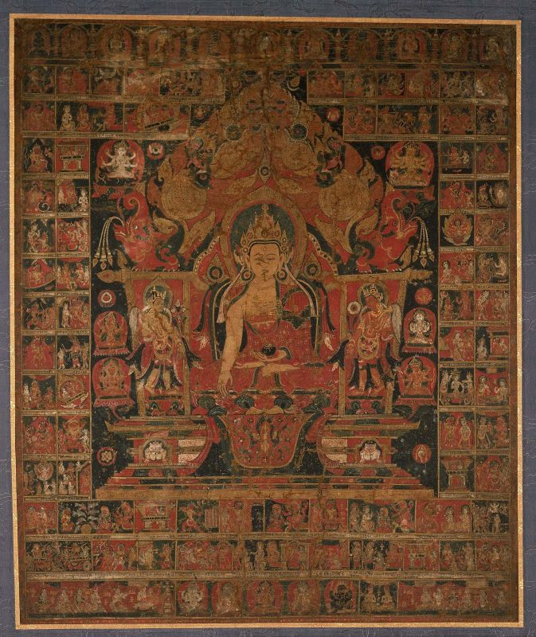
Recalling former lives (jātakas)

Slide 41
Gods request Buddha to Teach

Slide 42
Gift of begging bowl and food from the Two Merchants: Trapusa and Bhallika

Slide 43
H i m a l a y a s

Slide 44
First Sermon in the Deer Park, Sarnath, near Varanasi

Slide 45
Creation of the Sangha, Sarnath

Slide 46
Teaching:
Buddhism as world’s first missionary religion

Slide 47
Conversion of major religious teachers:
Kashyapa, and a
Naga Pacified

Slide 48
Conversion of Kashyapa: meditation during flood

Slide 49
Miracle at Shravasti

Slide 50
Flight to Tushita Heaven to preach to his mother

Slide 51
Descent from Tushita Heaven

Slide 52
Supernormal Travel to Future Buddhist Lands [??]
Visit to Sri Lanka: “Sri Pada”
Burma: Visit to Mandalay

Slide 53
Sariputra and Maulgalayana Maulgalayana

Slide 54
Return to Kapilavastu

Slide 55
Siddhartha meets his father

Slide 56
Rahula and Yashodhara requesting the boy’s inheritance

Slide 57
40 years of itinerant preaching to all classes: ascetics, kings, householders, rich and poor

Slide 58
Forges ties between householders and sangha

Slide 59
Anathapindika
Donor of Jetavana Monastery

Slide 60
Visakha, Merchant Patroness
Donor of Eastern Monastery, Vaishali (Purvarama)

Slide 61
Sangha grows, rules formulated

Slide 62
Quelling a Dispute with Shakyas and Koliyas

Slide 63
Troubles with Devadatta, his cousin
1
2
3
4

Slide 64
Conversion of Angulimala

Slide 65
Gautami requests ordination of women

Slide 66
Final Instructions on Sangha, his last rites, shrine making

Slide 67
Last Moments…
Disgruntled monk Ajivaka

Slide 68
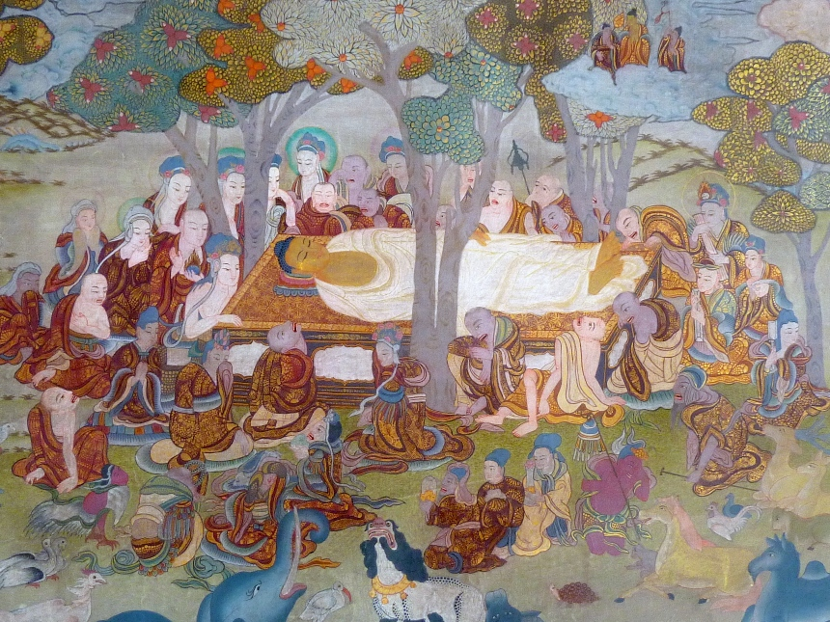
All creatures mourn the passing, human and non-human

Slide 69
Parinirvana

Slide 70
Casket and Self-Igniting Cremation Pyre

Slide 71
Gathering the relics

Slide 72
Division of the Relics
Among kings, naga king

Slide 73
Stûpa: Buddhist Reliquary

